Slide 1
Computational Skills for Informatics Workshop Series Galter Health Sciences Library
Introduction to the Command Line
Part I
https://github.com/galterdatalab/commandline_genomics/
Matt Carson (Galter): matthew.carson@northwestern.edu
Pamela Shaw (Galter): p-shaw2@northwestern.edu
Additional slide content contributors:
Janna Nugent: janna.nugent@northwestern.edu
Dusan Ramljak dusan@northwestern.edu
Alper Kinaci: akinaci@northwestern.edu
Christina Maimone: christina.maimone@northwestern.edu

Slide 2
Set up (if you haven’t already)
https://github.com/galterdatalab/commandline_genomics/
Click the green “Clone or download” button
Click ”Download ZIP”
Unzip the file to your computer’s desktop
Notes:
Adding colors to your terminal:
https://tiriboy.blogspot.com/2015/01/syntax-highlighting-bash-terminal-and.html
http://osxdaily.com/2012/02/21/add-color-to-the-terminal-in-mac-os-x/

Slide 3
What we’ll cover in part 1
File navigation
Examining files
Copying, moving, renaming, deleting
File permissions
Creating directories
Writing files with vi

Slide 4

Designed for ease of use:

Slide 5
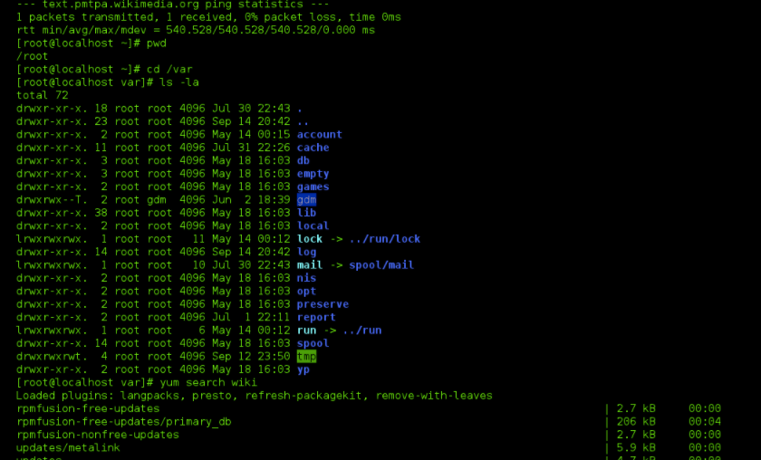

Designed for power
NOT
Designed for ease of use:

Slide 6
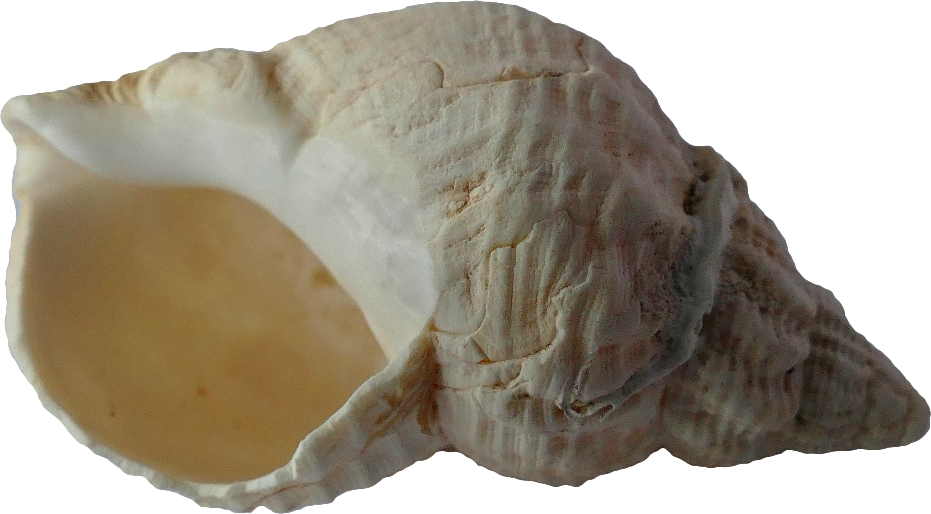
Introducing the Shell Why use it?
Hello, shell!
What do I do with this?
Photo by Anthony from Pexels
Notes:
A Unix shell is a command-line interpreter or shell that provides a command line user interface for Unix-like operating systems. The shell is both an interactive command language and a scripting language, and is used by the operating system to control the execution of the system using shell scripts.^{[2]}
Users typically interact with a Unix shell using a terminal emulator; however, direct operation via serial hardware connections or Secure Shell are common for server systems. All Unix shells provide filename wildcarding, piping, here documents, command substitution, variables and control structures for condition-testing and iteration.
https://en.wikipedia.org/wiki/Unix_shell

Slide 7
Why use the shell?
Many bioinformatics tools can only be used through a command line interface, or have extra capabilities in the command line version that are not available in the GUI.
The shell makes your work less boring. In bioinformatics you often need to do the same set of tasks with a large number of files. Learning the shell will allow you to automate those repetitive tasks and leave you free to do more exciting things.
Automating these repetitive tasks also reduces your chance of introducing errors to your workflow.
The shell makes your work more reproducible. When you carry out your work in the command-line (rather than a GUI), your computer keeps a record of every step that you’ve carried out, which you can use to re-do your work when you need to. It also gives you a way to communicate unambiguously what you’ve done, so that others can check your work or apply your process to new data.
Many bioinformatics tasks require large amounts of computing power and can’t realistically be run on your own machine. These tasks are best performed using HPC systems (Quest) or cloud computing, which may be accessed only through a shell.
- Adapted from the Data Carpentry Genomics Introduction to the Command Line lesson
Notes:
Some tools can only be accessed via the command line, or have extra functionality via a CLI
Lets you automate repetitive tasks and helps reduce errors, which enhances reproducibility of work
Command history is stored
Necessary for using Quest (or other Linux cluster)

Slide 8
Finder on my Mac
Notes:
Go to you’re the command-line-genomics folder that you downloaded…

Slide 9
looking around at files in Unix
Notes:
What are ~$...docx files?
These are document/template lock files. Every time a document is opened or a template accessed a (normally hidden) lock file is created in the same folder as the document/template. They should be removed whenever the document is closed, but they can remain if Word closes abnormally. See http://www.gmayor.com/what_to_do_when_word_crashes.htm
https://answers.microsoft.com/en-us/msoffice/forum/all/what-are-docx-files/d4c9d4be-292f-4ea9-927a-55aed60ebc35
Remove with rm ~\$*

Slide 10

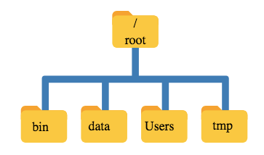

Slide 11


“Root”
a location: the base of the filesystem tree
/
a user: the superuser

Slide 12
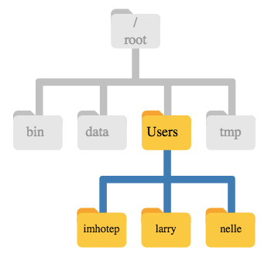

Root ≠ Home
/ ~
This is Nelle’s home directory
Notes:
Windows users should find your home directory at: C:\Users\[NetID]
Mac: /Users/[NetID]

Slide 13
Finder on my Mac

Slide 14
Getting Started
Launch your command line program
Type pwd, hit return
http://www.computerhh.co.uk/beginner.html
Notes:
Where are you? Most likely you are in your “home” directory. Type ls to see a list of files and directories. If you see “Desktop”, type cd Desktop. Now type cd commandline_genomics_master. Type ls again to see what’s here. Now type cd shell_data.

Slide 15
Some commands
pwd → ”print working directory”
cd <directory name> “change directory”
typing cd with nothing after it will take you to your home directory ( ~ )
ls → “list directory contents”
Each of these commands accepts arguments, which are preceded by a -
man <command> gives you the manual for a bash command
Hit space key to move forward in the manual, b to move back, and q to exit the manual
Notes:
Let’s add the flag ls –F to ls command to see whether the contents of a directory are files or other directories. This is called a “flag”. you can find out about arguments for ls, you can look it up in the manual. type man ls.

Slide 16
Notes:
We’re in the shell_data directory, so let’s type ls –l.
We see the owner and permissions for the file. We’ll talk about permissions in a later lesson.
Now let’s cd into untrimmed_fastq by using tab completion. type ‘cd untr<tab>’

Slide 17
Tab completion
Use the tab key to auto-complete a file or directory name, or even commands
Saves time
Avoids spelling or typing errors
But: Only auto-completes unique words
For entries that have similar names, you can hit tab again
Works for program names, too
Notes:
Now that we’re in the untrimmed_fastq directory, if we try to type ls SR<tab> we only see SRR09 because both files start with that. Hit tab twice to see both files listed.

Slide 19

Navigating Files & Directories
Photo by aitoff from Pixabay

Slide 20
Navigational shortcuts
Use .. (two dots) to move up one level
You can string them together
E.g. ls ../../ shows the contents of two levels above your current working directory
The tilde (~) is your home directory
The / is your root directory (we’ve already seen that)
Notes:
First, pwd to see where you are.
Now navigate to your command_line_genomics_master.
Now type ‘ls data_shell’.
you can see the contents of that directory without moving to it.
Similarly, if you want to move directly to another folder below the current one, just type cd and the path: eg. cd shell_data/sra_metadata (don’t forget tab complete can help you)

Slide 21
Finding hidden directories and files
Hint: try using man ls to look up the argument you need for ls to find hidden objects
Notes:
man ls
ls –a
cd .hidden
ls

Slide 22
Absolute vs relative paths
This is the full file path to the commandline_genomics_master directory on my Mac:
I can see it by typing ‘pwd’ while in commandline_genomics_master
/Users/mbc400/Desktop/commandline_genomics-master
Notes:
I can type the whole path in to get to shell_data, but if I’m already in commandline_genomics_master, I don’t have to. I just type cd shell_data. This is a relative path (relative to where I am now)

Slide 23
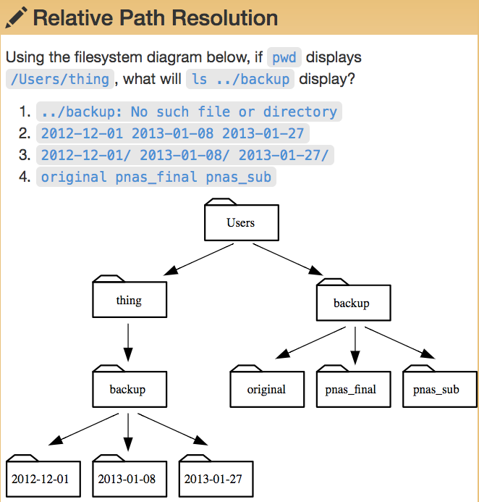
Notes:
Correct answer: #4

Slide 24
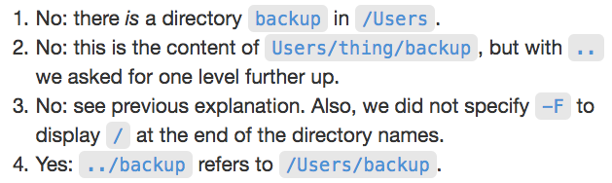
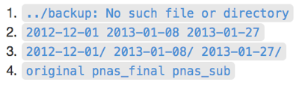
Notes:
Correct answer: #4

Slide 25
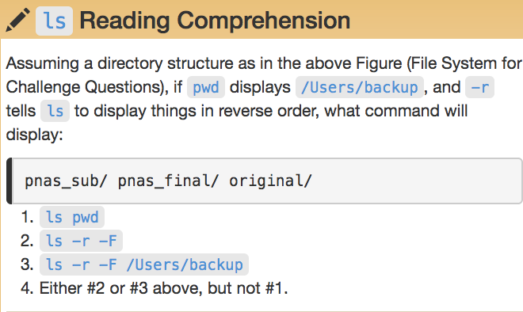
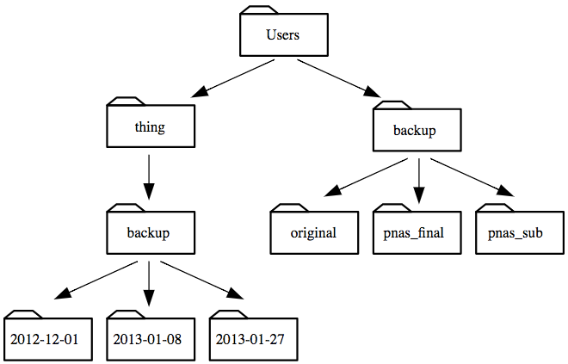
Notes:
Correct answer: #4

Slide 26
Notes:
Correct answer: #4

Slide 28
Working With Files & Directories

Slide 29
Wildcards

Slide 30
Wildcards
Navigate to the untrimmed_fastq directory
You can find all the fastq files by using a wildcard (*)
ls *.fastq
You can use wildcards to find programs, too…
ls /usr/bin/*.sh

Slide 31
Wildcards
* matches 0 or more characters
? matches only one character
[ ] matches a single occurrence of any of the characters typed in the brackets
Example:
l[aeio]st.sh would find last.sh, lest.sh, list.sh, and lost.sh (if they all existed in the directory)

Slide 32
Some notes about the root directory (/)

Slide 36
Command History
Use the up arrow to go back one command in your history (until you hit the earliest command)
Use the down arrow to go forward in your history (until you hit the last command)
Control c will cancel the current command and give you a new prompt
Control r will let you do a reverse search in your commands (very useful)
Control l or clear will clear your screen

Slide 37
Command History
Use history to get the history of your commands (over several sessions)
You get a numbered list of your commands
Type !<command number> to rerun a specific command

Slide 38

Examining Files
Photo by Pixabay from Pexels

Slide 39
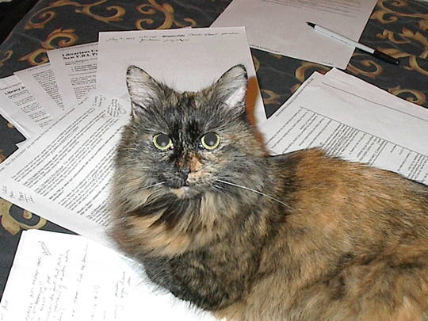
Examining Files
Use cat <filename> to view/read the contents of a file
Cat reads file
Exercise:
From your home directory, and without changing directories, use one short command to print the contents of all of the files in the /shell_data/untrimmed_fastq directory.
Notes:
Start in your untrimmed_fastq directory. type cat SRR098026.fastq.
solution:
cd ~
cat ~/Desktop/commandline_genomics-master/shell_data/untrimmed_fastq/*.fastq
(may be different on different computers)

Slide 40
Examining Files
cat prints out the whole file
use less <filename> to open the file as read-only and navigate through it

Slide 41
Examining Files
less also lets you search the file
while in less, type / then the sequence you’re looking for
Shortcuts:
To search forward in less, type / and return to get the next occurrence
To search backwards, type ? and return to get the previous occurrence
Notes:
Navigate back to the untrimmed_fastq directory:
cd Desktop/commandline_genomics-master/shell_datal/untrimmed_fastq/
Try less SRR097977.fastq. Then type /TTTTT. Type /return to see the next occurrence, or ?return to see previous
q to quit

Slide 42
Head and tail
Examining Files
head <filename> lets you see the first 10 lines of a file
tail <filename> lets you see the last 10 lines of a file
You can add -n to head or tail to specify the number of lines you want to see
Notes:
Try head SRR097977.fastq. Then try tail. Then try head –n 4 SRR098026.fastq. Same for tail.

Slide 43
Quick FASTQ file format reminder
Line 1 begins with a '@' character and is followed by a sequence identifier and an optional description (like a FASTA title line).
Line 2 is the raw sequence letters.
Line 3 begins with a '+' character and is optionally followed by the same sequence identifier (and any description) again.
Line 4 encodes the quality values for the sequence in Line 2, and must contain the same number of symbols as letters in the sequence.

Slide 44
Quick FASTQ file format reminder

Slide 45
Creating, Moving, Copying and Removing Files

Slide 46

Copying Files
Photo by aitoff from Pixabay

Slide 47
Copying Files
cp <filename> <new_filename>
Try this with SRR098026.fastq in the shell_data/untrimmed_fastq directory, and call it SR098026-copy.fastq
List the files
Notes:
It’s always a good idea to save the original data, so making a backup copy is one way to ensure that the original stays as it is.
cp SRR098026.fastq SRR098026-copy.fastq
ls

Slide 48

Creating Directories
Nope, not this easy
Photo by www_slon_pics from Pixabay

Slide 49
Creating Directories
mkdir <filename> creates a directory with the name you choose
Try mkdir backup
Notes:
mkdir backup

Slide 50
Moving / Renaming
Notes:
mkdir backup

Slide 51
Moving / Renaming
mv <filename> <directory> will move a file to a different directory
mv is also the command for renaming files (without copying)
mv <filename> <new_filename>
Notes:
mv SRR098026-copy.fastq backup
ls backup
cd backup
mv SRR098026-copy.fastq SRR098026-backup.fastq
ls

Slide 52
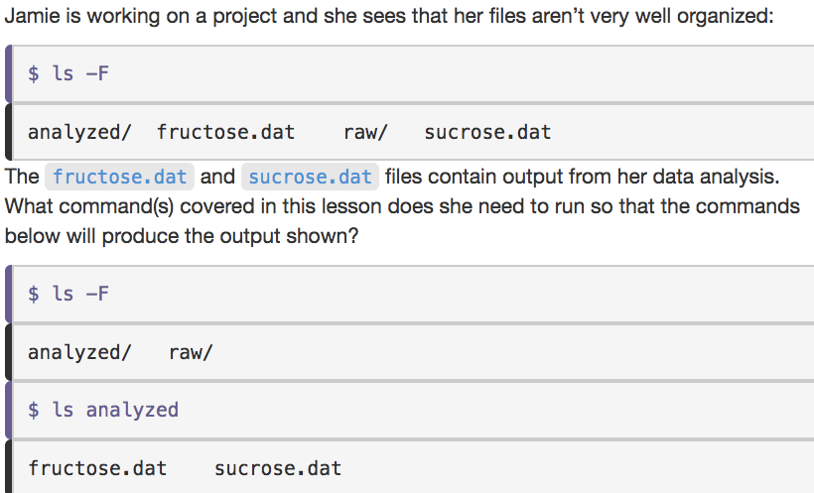


Slide 53
File Permissions

Slide 54
File Permissions
Notes:
Just because we created the backup doesn’t mean it’s safe from modifications, unless we protect it.
Make sure you’re in the untrimmed_fastq directory.
ls –l
shows you permissions
Most common file types are ‘-’ (regular non-directory file), ‘d’ (directory), and ‘l’ (symbolic link)
From https://www.zybuluo.com/haokuixi/note/27480:
The @ suffix is unique to Mac OS and it means the file has extended attributes. You can use the xattr command-line utility to view and modify them:
xattr --list filename
xattr --set propname propvalue filename
xattr --delete propname filename
The + suffix means the file has an access control list, and is common in any *nix that supports ACLs. Giving ls the -e flag will make it show the associated ACLs after the file, and chmod can be used to modify then. Most of this is from the chmod man page:
You add an ACL with chmod +a "type:name flag permission,...", and remove it with chmod -a. The argument to chmod is fairly complicated
Sticky bit: https://www.thegeekstuff.com/2013/02/sticky-bit/
Example: drwxrwxrwt

Slide 55
File Permissions
chmod -w <filename> will remove the “write” permission for the file
You can add or remove read, write, and execute permissions, depending on your own user level permissions in the file system
Notes:
let’s chmod –w SRR098026-backup.fastq
ls -l

Slide 56

Removing

Slide 57
Removing
rm <filename> will remove the file
Note: removing a file in the shell removes it forever. There is no trash can here.
rm will not remove directories
To remove a directory and its contents, use rm -r for “recursive” removal
To have the shell ask you if it’s okay to remove the file(s), add the -i flag for “interactive” mode
Notes:
Let’s try rm SRR098026-backup.fastq. Since we’ve write-protected it, the shell will ask us if it’s okay to override file permissions.
Now let’s recursively remove the directory ”backup. Move up to the directory above (using .. from the backup directory)
rm -r backup
if we have write-protected this file, we’ll be asked if we want to remove the files in the directory

Slide 58
Notes:
To protect yourself from accidently deleting or overwriting important files, consider setting ‘noclobber’:
From https://unix.stackexchange.com/questions/452865/are-there-any-disadvantages-of-setting-noclobber:
set -o noclobber
alias cp='cp -i’
alias mv='mv -i'

Slide 59

Writing Files
Photo by Pexels from Pixabay

Slide 60
Which command line editor?
vi/vim is the editor we’ll use today
takes some time to learn, but powerful
nano the editor used by the Carpentries lessons
easier to use than vi, but less powerful and not as flexible as vi
others
notepad in (some) Windows machines can be launched from the shell
emacs like vi takes some time to learn
More full-featured editors include Atom, Sublime Text, Text Wrangler, others

Slide 61

text editor: nano
type “nano <filename>” this will open the named file for editing or create it if it doesn’t exist
type your text: the mouse will not move the cursor - navigate with the arrow keys
save and quit: commands are on the bottom of the screen - the “^” stands for “control”

Slide 62
text editor: vi/vim
On command line: vi README.txt
You land in command mode
To enter insert mode: “i” where the cursor is; “o” inserts one line below that
Navigate with arrow keys
To exit insert mode: “esc”
To save: “:w”
To exit: “:q”
To exit without saving: “q!”
Notes:
Lets’s start in the shell_data/untrimmed_fastq directory
vi README.txt
hit “i”
Type in some lines of text describing the files: what they contain, how many, location of backup files (if any). there’s not much to say about them right now, but in real life, we would update this readme file as we make edits.
When done, hit esc key, type :w, then :q

Slide 63
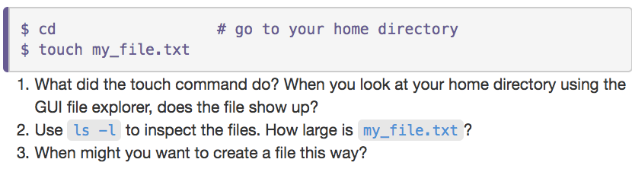
Touch: make an empty file

Slide 64

End of Part 1!!
Part 2 next week

Slide 65
Computational Skills for Informatics Workshop Series Galter Health Sciences Library
Introduction to the Command Line
Part II
https://github.com/galterdatalab/commandline_genomics/
Matt Carson (Galter): matthew.carson@northwestern.edu
Pamela Shaw (Galter): p-shaw2@northwestern.edu
Additional slide content contributors:
Janna Nugent: janna.nugent@northwestern.edu
Dusan Ramljak dusan@northwestern.edu
Alper Kinaci: akinaci@northwestern.edu
Christina Maimone: christina.maimone@northwestern.edu

Slide 66
Set up (if you haven’t already)
https://github.com/galterdatalab/commandline_genomics/
Click the green “Clone or download” button
Click ”Download ZIP”
Unzip the file to your computer’s desktop
Notes:
Adding colors to your terminal:
https://tiriboy.blogspot.com/2015/01/syntax-highlighting-bash-terminal-and.html
http://osxdaily.com/2012/02/21/add-color-to-the-terminal-in-mac-os-x/

Slide 67
Review from last week
We covered:
how to move around in directories
how to access the manual for commands
absolute vs relative paths
how to use wildcards to find files
how to access the command history
how to open and read / examine files
how to create, move, rename, copy, & remove files
file permissions
how to write files with vi and create an empty file with touch

Slide 68
Some of what we didn’t cover
file
pushd, popd (helps you navigate efficiently)
cd -
Finding files and programs from the command line:
locate (to set up on MacOSX, sudo /usr/libexec/locate.updatedb)
which (example 'cal’)
find
How to get info about commands:
whatis (what does command x do?)
apropos
man (‘help’ on GitBash, but not complete)
sudo (which is pronounced “soo-doo”)
Notes:
$ file solar.pdf
solar.pdf: PDF document, version 1.3
# Locate update command
$ sudo /usr/libexec/locate.updatedb
apropos: Each manual page has a short description available within it. apropos searches the descriptions for instances of keyword.
find:
find ./ -type f|d -name 'README.md'
find ./ -type f -perm 775 -user mbc400
# Have to create ./shell_data/molecules_backup directory first
find ./shell_data/molecules/ -type file -name '*.pdb' -exec cp '{}' ./shell_data/molecules_backup \;
find -type f -mtime -30 -exec ls '{}' ./ \; # doesn't work

Slide 69

Redirection
Photo by Pixabay from Pexels

Slide 70

Searching within a file (without opening it)
Photo by Pixabay from Pexels

Slide 71
grep
grep <string to search> <filename> allows you to search a text file for a string without opening the file
Make sure you’re in the shell_data/untrimmed_fastq directory…
We’re going to search for 10 consecutive unknown nucleotides (Ns), which suggest poor-quality reads:
grep NNNNNNNNNN SRR098026.fastq
If we want the whole read, we need the line before and two lines after the nucleotide read:
grep -B1 -A2 NNNNNNNNNN SRR098026.fastq
Notes:
cd ~/Desktop/commandline_genomics-master/shell_data/untrimmed_fastq
You’re going to get a BUNCH of stuff from the grep command, but it’s all just lines of nucleotide reads with Ns.
We probably want the read identifier and perhaps the quality score or other information from all 4 lines of the fastq read.

Slide 72
Sequence to match:
GNATNACCACTTCC
AAGTT
Notes:
grep –B1 GNATNACCACTTCC SRR098026.fastq
grep –B1 AAGTT *.fastq

Slide 73
Notes:
$ grep -B1 GNATNACCACTTCC SRR098026.fastq
@SRR098026.245 HWUSI-EAS1599_1:2:1:2:801 length=35
GNATNACCACTTCCAGTGCTGANNNNNNNGGGATG
$ grep -B1 AAGTT *.fastq
SRR097977.fastq-@SRR097977.11 209DTAAXX_Lenski2_1_7:8:3:247:351 length=36
SRR097977.fastq:GATTGCTTTAATGAAAAAGTCATATAAGTTGCCATG
--
SRR097977.fastq-@SRR097977.67 209DTAAXX_Lenski2_1_7:8:3:544:566 length=36
SRR097977.fastq:TTGTCCACGCTTTTCTATGTAAAGTTTATTTGCTTT
--
SRR097977.fastq-@SRR097977.68 209DTAAXX_Lenski2_1_7:8:3:724:110 length=36
SRR097977.fastq:TGAAGCCTGCTTTTTTATACTAAGTTTGCATTATAA
--
SRR097977.fastq-@SRR097977.80 209DTAAXX_Lenski2_1_7:8:3:258:281 length=36
SRR097977.fastq:GTGGCGCTGCTGCATAAGTTGGGTTATCAGGTCGTT
--
SRR097977.fastq-@SRR097977.92 209DTAAXX_Lenski2_1_7:8:3:353:318 length=36
SRR097977.fastq:GGCAAAATGGTCCTCCAGCCAGGCCAGAAGCAAGTT
--
SRR097977.fastq-@SRR097977.139 209DTAAXX_Lenski2_1_7:8:3:703:655 length=36
SRR097977.fastq:TTTATTTGTAAAGTTTTGTTGAAATAAGGGTTGTAA
--
SRR097977.fastq-@SRR097977.238 209DTAAXX_Lenski2_1_7:8:3:592:919 length=36
SRR097977.fastq:TTCTTACCATCCTGAAGTTTTTTCATCTTCCCTGAT
--
SRR098026.fastq-@SRR098026.158 HWUSI-EAS1599_1:2:1:1:1505 length=35
SRR098026.fastq:GNNNNNNNNCAAAGTTGATCNNNNNNNNNTGTGCG

Slide 74
Redirecting output
grep sends results to your terminal by default, but you can also send the results to a file
You do this by using “redirection” via a “>”
E.g.:
grep –B1 –A2 NNNNNNNNNN SRR098026.fastq > bad_reads.txt
It may look like nothing happens, but check with ls
If you redirect to the same file again with >, the contents will be overwritten
To redirect without overwriting the file, use “append redirect” (>>)
Notes:
You might be confused about why we’re naming our output file with a .txt extension. After all, it will be holding FASTQ formatted data that we’re extracting from our FASTQ files. Won’t it also be a FASTQ file? The answer is, yes - it will be a FASTQ file and it would make sense to name it with a .fastq extension. However, using a .fastq extension will lead us to problems when we move to using wildcards later in this episode. We’ll point out where this becomes important.

Slide 75
Echo and append redirect

Slide 76
Word count
wc <filename> gives us a count of lines, words, & characters in a file
wc –l <filename> (just the lines)
wc –w <filename> (just the words, etc.)
Try it out:
wc bad_reads.txt
wc –l bad_reads.txt
Notes:
$ wc bad_reads.txt
802 1338 24012 bad_reads.txt
$ wc -l bad_reads.txt
802 bad_reads.txt
$ wc -w bad_reads.txt
1338 bad_reads.txt

Slide 77
Word count
Hint: start by finding all the sequence lines with at least 3 Ns and write them to bad_reads.txt (overwrite the file)
Notes:
Lets take all the sequence lines with at least 3 consecutive Ns and write them to bad_reads.txt (overwrite)
$ grep NNN SRR098026.fastq > bad_reads.txt
$ wc -l bad_reads.txt
249 bad_reads.txt
This is why we didn’t call bad_reads a fastq file, because it would have been included in the grep search

Slide 78

Pipes & Filters
Photo by Tim Mossholder from Pexels

Slide 79
Pipes
Pipes let you string together multiple bash commands in a single line of code
This saves you from creating intermediate files that you don’t want later (keeps your directories cleaner)
Try it: grep -B1 -A2 NNNNNNNNNN SRR098026.fastq | wc -l
Notes:
Remember how we sent our reads with 10 Ns or more to bad_reads.txt, then we did a wc –l on them?
We don’t have to create the bad_reads.txt file if all we want is the number of bad reads.
$ grep -B1 -A2 NNNNNNNNNN SRR098026.fastq | wc -l
802

Slide 80
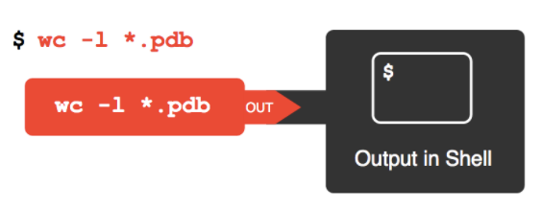
Go to commandline_genomics-master/shell_data/molecules
Run the following command:
Notes:
We have some more data files for you to work with
Go up to the shell_data directory, then into molecules: cd ../molecules
Now execute the command on the screen
$ wc -l *.pdb
20 cubane.pdb
12 ethane.pdb
9 methane.pdb
30 octane.pdb
21 pentane.pdb
15 propane.pdb
107 total

Slide 81
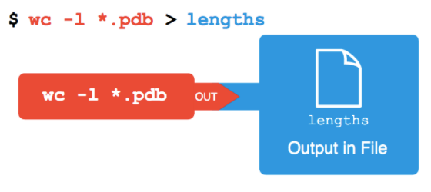
Hit the up arrow on your keyboard, then add > lengths.txt
Run the command:
Notes:
Do the same command (hit the up arrow on your keyboard), then add > lengths.txt
No output on the screen; it all went into ’lengths’

Slide 82
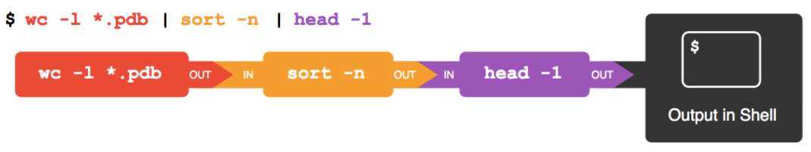
Now we’ll string multiple commands together using ‘|’
Run the first 2 commands so you can see what sort does…
then hit the up arrow and add the third pipe.
sort and wc are called “filters”
Notes:
Now try these commands.
Do just the first 2 first so you can see what sort did.
Then hit the up arrow and add the third pipe.
Sort and wc are called “filters”
$ wc -l *.pdb | sort -n
9 methane.pdb
12 ethane.pdb
15 propane.pdb
20 cubane.pdb
21 pentane.pdb
30 octane.pdb
107 total
$ wc -l *.pdb | sort -n | head -1
9 methane.pdb
If you want the largest file, sort –nr and head -2

Slide 83
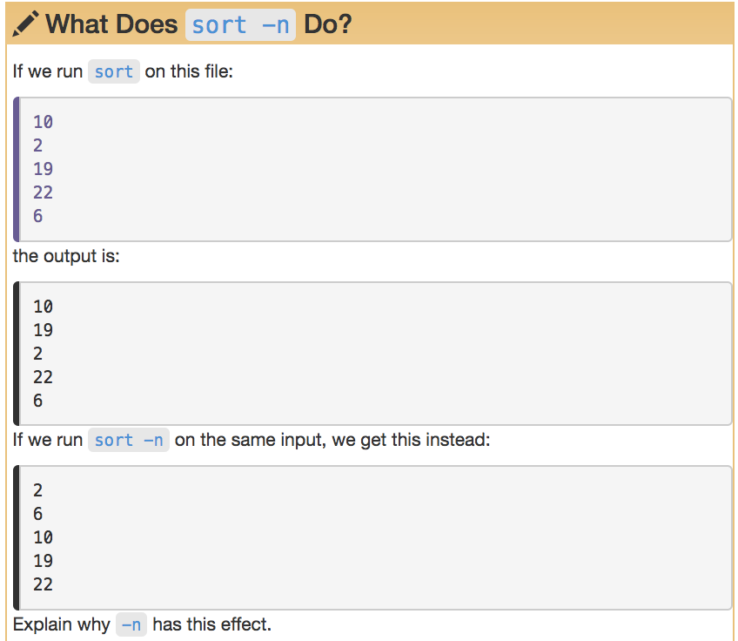
Notes:
By default, sort sort character by character, so 10 comes before 2.
-n:
Sort fields numerically by arithmetic value. Fields are supposed to have optional blanks in the beginning, an optional minus sign, zero or more digits (including decimal point and possible thousand separators).

Slide 84
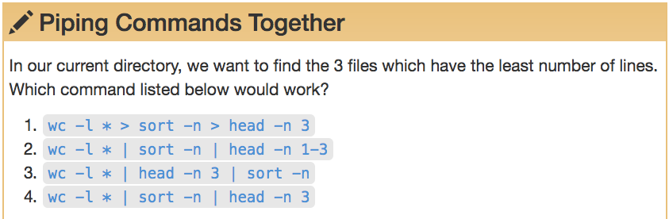
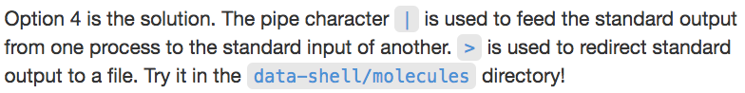
Notes:
Make sure you’re still in molecules directory.
$ wc -l * > sort -n head -n 3
wc: -n: open: No such file or directory
wc: head: open: No such file or directory
wc: -n: open: No such file or directory
wc: 3: open: No such file or directory
$ wc -l * | sort -n | head -n 1-3
head: illegal line count -- 1-3
# This takes only the first 3 files from wc –l output and sorts them
$ wc -l * | head -n 3 | sort -n
7 lengths
12 ethane.pdb
20 cubane.pdb
$ wc -l * | sort -n | head -n 3
7 lengths
8 sort
9 methane.pdb

Slide 85
More filters : cut
cut <delimiter> <field> <filename> pulls out certain sections of each line of a text file and writes them out
cut assumes that the file is tab delimited. If your file is other-delimited (comma most common) use the -d flag
Try it: cut -d , -f 2 animals.txt
field delimiter flag
field number
filename
delimiter flag
comma delimiter
Notes:
Make sure you’re in the shell_data/data directory:
animals.txt:
2012-11-05,deer
2012-11-05,rabbit
2012-11-05,raccoon
2012-11-06,rabbit
2012-11-06,deer
2012-11-06,fox
2012-11-07,rabbit
2012-11-07,bear
$ cut -d , -f 2 animals.txt
deer
rabbit
raccoon
rabbit
deer
fox
rabbit
bear

Slide 86
More filters: uniq
uniq filters out adjacent matching lines in a file
If you don’t want duplicates in the output, you might have to sort first
How would you do this to the list you just created to find out what animals are in the file, without any duplicates ?
Notes:
Make sure you’re still in the /data directory for this one
$ cut -d , -f 2 animals.txt | sort
bear
deer
deer
fox
rabbit
rabbit
rabbit
raccoon
$ cut -d , -f 2 animals.txt | sort | uniq
bear
deer
fox
rabbit
raccoon

Slide 87
shell_data/data/
Notes:
1. $ sort animals.txt | uniq -c
1 2012-11-05,deer
1 2012-11-05,rabbit
1 2012-11-05,raccoon
1 2012-11-06,deer
1 2012-11-06,fox
1 2012-11-06,rabbit
1 2012-11-07,bear
1 2012-11-07,rabbit
2. # sort using comma as a separator, sorting only on the second column (,2 is optional)
$ sort -t, -k2,2 animals.txt | uniq -c
1 2012-11-07,bear
1 2012-11-05,deer
1 2012-11-06,deer
1 2012-11-06,fox
1 2012-11-05,rabbit
1 2012-11-06,rabbit
1 2012-11-07,rabbit
1 2012-11-05,raccoon
3. $ cut -d , -f 2 animals.txt | uniq -c
1 deer
1 rabbit
1 raccoon
1 rabbit
1 deer
1 fox
1 rabbit
1 bear
4. $ cut -d , -f 2 animals.txt | sort | uniq -c
1 bear
2 deer
1 fox
3 rabbit
1 raccoon
5. # This one just returns a count of the number of lines in the file (including duplicates because we didn’t sort first)
$ cut -d , -f 2 animals.txt | uniq -c | wc -l
8

Slide 88
For Loops

Slide 89
What loops do
Loops allow us to perform commands repeatedly or on multiple files
They reduce likelihood of typing errors and save time
The shell sees the word for and knows to repeat a command (or commands) for each item in a list
Items in the list are assigned, in sequence to a variable
Variables are designated by a $

Slide 90
The formula of a loop
for <variable> in <group to iterate over>
do
<operation using variables>
done
A note about the prompt:
You’ll notice the prompt changes from a $ (or whatever your prompt is), to a >.
This is to tell you that you are in the middle of a loop.
Notes:
READ SLIDE
Let’s try an example of this…[next slide]

Slide 91
The formula of a loop
for filename in basilisk.dat minotaur.dat unicorn.dat
do
head -n 2 $filename | tail -n 1
done
Type this command in your shell one line at a time.
After the first line, your prompt will become ‘>’.
After you type ‘done’, you should receive output.
Notes:
Let’s do it in the shell! Go to the creatures directory:
cd ../creatures
for filename in basilisk.dat minotaur.dat unicorn.dat
> do
> head -n 2 $filename | tail -n 1
> done
CLASSIFICATION: basiliscus vulgaris
CLASSIFICATION: bos hominus
CLASSIFICATION: equus monoceros
What did it do? Took the first 2 lines of each file, sent that to tail and took only the last line and printed out the list.
WHY? because we only want the classification of each creature.

Slide 92
Notes:
Let’s try an example in the shell to illustrate:
Sometimes you expand a variable and not have any whitespace after it. To do that, you need to put braces (curly brackets) around the variable name. Like so:
$ foo=abc
$ echo foo
foo
$ echo foo is $foo
foo is abc
$ echo foo is $fooEFG # Doesn’t work
foo is
$ echo foo is ${foo}EFG
foo is abcEFG
${} are useful if you want to expand the variable foo in the string "${foo}bar"
Curly braces are also unconditionally required when:
expanding array elements, as in ${array[42]}
using parameter expansion operations, as in ${filename%.*} (remove extension)
expanding positional parameters beyond 9: "$8 $9 ${10} ${11}"
https://stackoverflow.com/questions/8748831/when-do-we-need-curly-braces-around-shell-variables

Slide 93
Best Practices for File and Directory Names
Don’t use whitespace (“my work”)
Don’t begin the name with a dash “-”
Don’t begin the name with a “.” unless you mean it
Use letters, numbers, “-”, “_”, “.”
If you need to use a file name with special characters,
surround the name in quotes when you write your scripts (“- a bad name !”)
Notes:
*nix systems allow you to use any character but ‘/’ (byte value \057) and ‘NUL’ (byte value \000).
But there are best practices that say you should avoid:
/
>
<
|
:
&
Other characters, including whitespace, can cause inconvenience and may prevent scripts from functioning properly.
Characters like <, >, |, \, :, (, ), &, ;, as well as wildcards such as ? and *, to be quoted or escaped using \ symbol.
For example, what happens when you type:
touch file's.txt
> ‘
touch file\'s.txt will work, but not advised
It’s generally best practice to not use spaces in file names

Slide 95
Using a loop to write to a file
Instead of sending output to the terminal, you can use loops to write to a file
Just remember that when you use redirect, you should be using >> so that you don’t overwrite your file every time the loop executes

Slide 96
Using a loop to write to a file
for filename in basilisk.dat minotaur.dat unicorn.dat
do
head -n 2 $filename | tail -n 1 >> species.txt
done
for filename in *.dat
do
head -n 2 ${filename} | tail -n 1 >> creature-species.txt
done
There’s more than one way to do it
Notes:
Let’s do exactly the same thing we did before, but write it to a file called species.txt:
for filename in basilisk.dat minotaur.dat unicorn.dat
> do
> head -n 2 $filename | tail -n 1 >> species.txt
> done
for filename in basilisk.dat minotaur.dat unicorn.dat; do head -n 2 $filename | tail -n 1 >> species.txt; done
Make sure you’re in the /shell_data/creatures directory
We’re going to write it a little differently and create a different text file, so we can compare
for filename in *.dat
> do
> head -n 2 ${filename} | tail -n 1 >> creature-species.txt
> done
for filename in *.dat; do head -n 2 ${filename} | tail -n 1 >> creature-species.txt; done
So: we used a wildcard for .dat filenames and curly brackets for the filename variable, which isn’t necessary, bit it’s not a bad practice
NOTE: You still need “ “ around $filename if you want to catch file names with spaces.

Slide 97
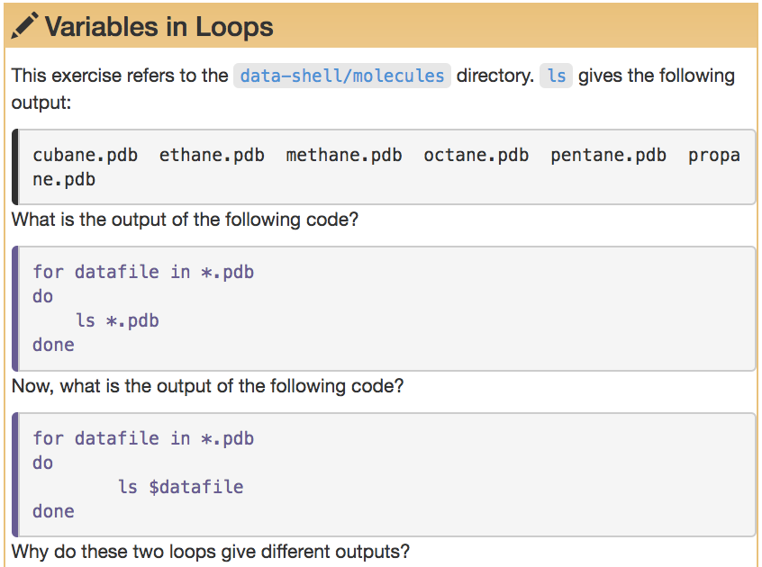
shell_data/molecules
Notes:
Try both to see how they look.
Go to molecules directory:
cd ../molecules
$ for datafile in *.pdb
> do
> ls *.pdb
> done
cubane.pdb ethane.pdb methane.pdb octane.pdb pentane.pdb propane.pdb
cubane.pdb ethane.pdb methane.pdb octane.pdb pentane.pdb propane.pdb
cubane.pdb ethane.pdb methane.pdb octane.pdb pentane.pdb propane.pdb
cubane.pdb ethane.pdb methane.pdb octane.pdb pentane.pdb propane.pdb
cubane.pdb ethane.pdb methane.pdb octane.pdb pentane.pdb propane.pdb
cubane.pdb ethane.pdb methane.pdb octane.pdb pentane.pdb propane.pdb
$ for datafile in *.pdb
> do
> ls $datafile
> done
cubane.pdb
ethane.pdb
methane.pdb
octane.pdb
pentane.pdb
propane.pdb

Slide 98
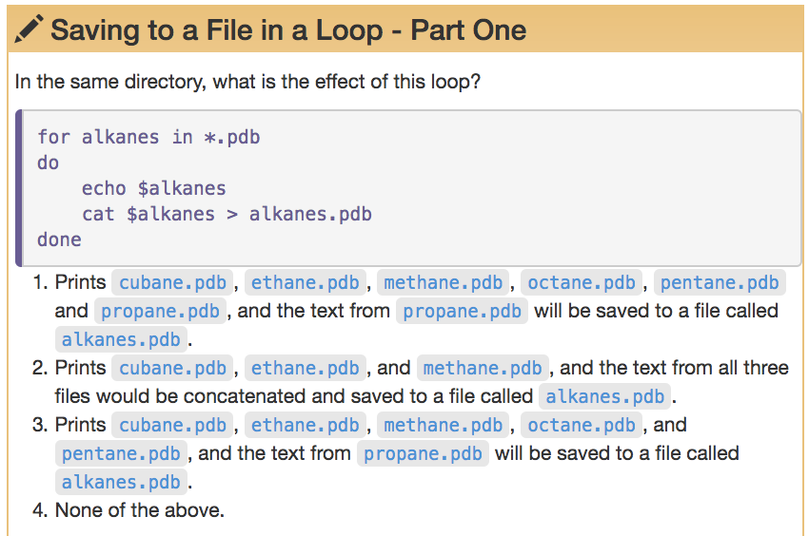
Notes:
$ for alkanes in *.pdb
> do
> echo $alkanes
> cat $alkanes > alkanes.pdb
> done
cubane.pdb
ethane.pdb
methane.pdb
octane.pdb
pentane.pdb
propane.pdb

Slide 99
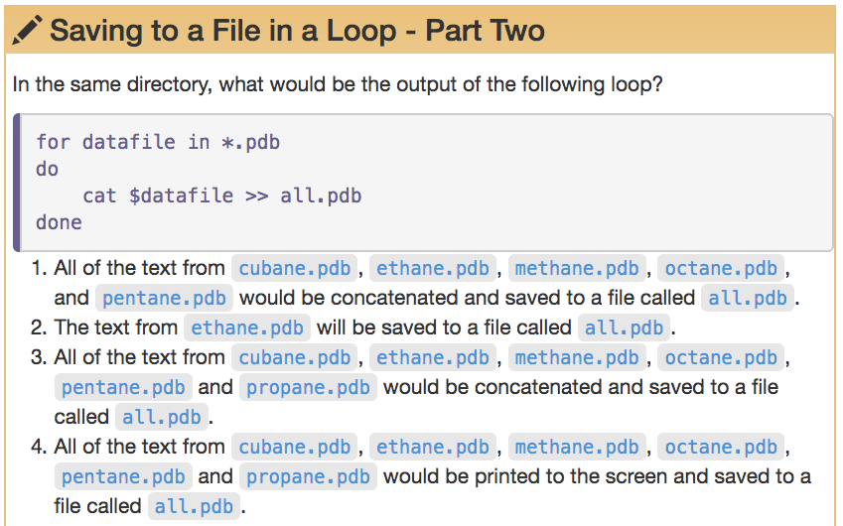
Notes:
$ for datafile in *.pdb
> do
> cat $datafile >> all.pdb
> done
# 3 is the right answer

Slide 100
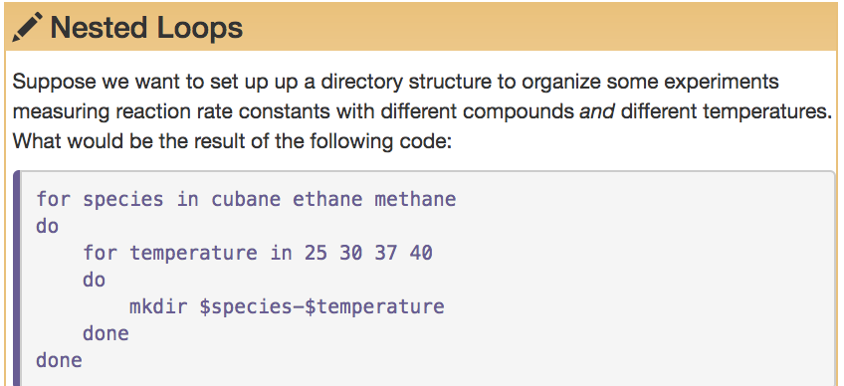
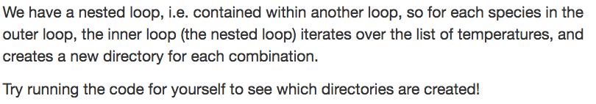
Notes:
$ for species in cubane ethane methane
> do
> for temperature in 25 30 37 40
> do
> mkdir $species-$temperature
> done
> done

Slide 101
Using basename in for loops
basename is a *nix feature that is really powerful when used in a for loop. It allows you to access just the file prefix, which you can use to name things.
Note: this does not change the files; it just creates variables without the file extensions
Let’s try this in the /creatures directory by removing all the .txt extensions, then using the mv command and adding the year to them
Notes:
Make sure you’re in the creatures directory:
cd ../creatures

Slide 102
Using basename in for loops
Notes:
basename requires us to use the filename, then specify the part we want to remove (the .txt in this case)
$ for filename in *.txt
> do
> name=$(basename ${filename} .txt)
> mv ${filename} ${name}_2019.txt
> done
Results in: creature-species_2019.txt. species_2019.txt

Slide 104
Shell Scripts

Slide 105
text editor: nano
type “nano <filename>” this will open the named file for editing or create it if it doesn’t exist
type your text: the mouse will not move the cursor - navigate with the arrow keys
save and quit: commands are on the bottom of the screen - the “^” stands for “control”

Slide 106
text editor: vi/vim
On command line: vi bad-reads-script.sh
You land in command mode
To enter insert mode: “i” where the cursor is; “o” inserts one line below that
Navigate with arrow keys
To exit insert mode: “esc”
To save: “:w”
To exit: “:q”
To exit without saving: “q!”
Notes:
Lets’s start in the shell_data/untrimmed_fastq directory

Slide 107
text editor: vi/vim
On command line: vi bad-reads-script.sh
You land in command mode
To enter insert mode: “i” where the cursor is; “o” inserts one line below that
Navigate with arrow keys
To exit insert mode: “esc”
To save: “:w”
To exit: “:q”
To exit without saving: “q!”
Lets’s start in the shell_data/untrimmed_fastq directory:
bash-3.2$ vi bad-reads-script.sh
Type “i”
Type:
grep -B1 -A2 NNNNNNNNNN *.fastq > scripted_bad_reads.txt
When done, hit esc key, type :w, then q
Notes:
Lets’s start in the shell_data/untrimmed_fastq directory:
vi bad-reads-script.sh
hit “i”
Type
grep -B1 -A2 NNNNNNNNNN *.fastq > scripted_bad_reads.txt
When done, hit esc key, type :w, then :q
OR
Type :wq!

Slide 108
Running the script in the shell
Now we can run the script in the shell: bash bad-reads-script.sh
It looks like nothing happened, but…if you run the following:
less scripted_bad_reads.txt
It worked!

Slide 109
Making your script into an executable program
Running a script from bash is great, but you will want your scripts to run on their own. For this you need to change the permissions, as we mentioned earlier.
ls –l bad-reads-script.sh
chmod +x bad-reads-script.sh
The +x makes your program executable. Now you can run it without typing “bash”
./bad-reads-script.sh

Slide 110
More shell scripts,
with variables
If we want the user to select lines from a file of their choosing, we can use variables in our shell scripts
We use variables “$1”, “$2”, “$3”, etc. for any data we want the user to input
We use quotes around the variables, in case there are spaces in filenames or the user’s entry
Let’s write a script to allow the user to select the middle lines from a file in the molecules directory
Notes:
cd ../molecules
vi middle.sh
i
# Select lines from the middle of a file.
# Usage: bash middle.sh filename end_line num_lines
head -n "$2" "$1" | tail -n "$3”
esc
:w :q
now run it:
bash middle.sh pentane.pdb 15 5

Slide 111
More shell scripts,
with variables
cd ../molecules
vi middle.sh
Type “i”
# Select lines from the middle of a file.
# Usage: bash middle.sh filename end_line num_lines
head -n “$2” “$1” | tail -n “$3”
Hit ESC
Type :wq!
Now run the command: bash middle.sh pentane.pdb 15 5
Notes:
If you get the following error when you run the command, you probably copied it from the slide and have some formatting problems:
head: illegal line count -- “15”
tail: illegal offset -- “5”
You can also type chmod +x middle.sh and execute the file like this: ./middle.sh pentane.pdb 15 5

Slide 112
More shell scripts,
with variables
If we want the user to select lines from more than one file, we will need to use a variable that stands for any file
We use the variable “$@” to stand for any file that matches the user’s criteria for any data we want the user to supply
Let’s write a script to allow the user to sort files by their length

Slide 113
More shell scripts,
with variables
Stay in commandline_genomics-master/shell_data/molecules
vi sorted.sh
Type “i”
# Sort files by their length.
# Usage: bash sorted.sh one_or_more_filenames
wc -l "$@" | sort –n
Hit ESC
Type :wq!
Now run the command: bash sorted.sh *.pdb
Notes:
If you get the following error when you run the command, you probably copied it from the slide and have some formatting problems:
sort: No such file or directory
$ bash sorted.sh *.pdb
9 methane.pdb
12 ethane.pdb
15 alkanes.pdb
15 propane.pdb
20 cubane.pdb
21 pentane.pdb
30 octane.pdb
122 all.pdb
244 total

Slide 114
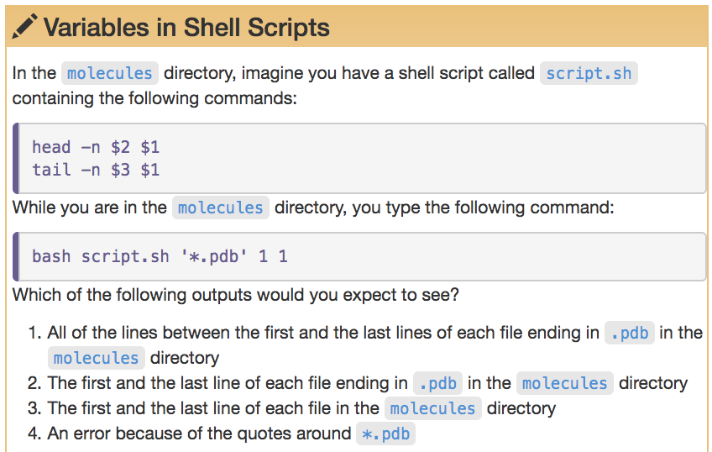
Notes:
$ bash script.sh '*.pdb' 1 1
==> alkanes.pdb <==
COMPND PROPANE
==> all.pdb <==
COMPND PROPANE
==> cubane.pdb <==
COMPND CUBANE
==> ethane.pdb <==
COMPND ETHANE
==> methane.pdb <==
COMPND METHANE
==> octane.pdb <==
COMPND OCTANE
==> pentane.pdb <==
COMPND PENTANE
==> propane.pdb <==
COMPND PROPANE
==> alkanes.pdb <==
END
==> all.pdb <==
END
==> cubane.pdb <==
END
==> ethane.pdb <==
END
==> methane.pdb <==
END
==> octane.pdb <==
END
==> pentane.pdb <==
END
==> propane.pdb <==
END

Slide 115
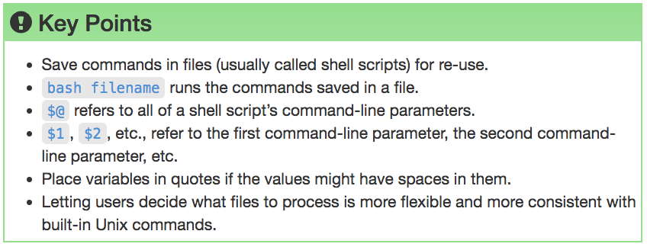

Slide 116
sed
A text stream editor that parses and transforms text by moving through each line of a file, character by character
Sed is great for simple text transformations (e.g., find/replace)
Often used with regular expressions (regexes)
Notes:
Bioinformatics one-liners: https://github.com/stephenturner/oneliners/blob/master/README.md

Slide 117
sed example
Go to commandline_genomics-master/shell_data/data/animal-counts
Take a look at the animals.txt file: less animals.txt
What if we want to replace all commas with spaces?
sed ‘s/,/ /g’ animals.txt
Take a look at the animals.txt file again: less animals.txt
Why does the file still have commas?
We need to add the ‘-i’ flag if we want to ‘edit in place’ and change the file
We just did a find/replace with sed using a regex
Notes:
$ sed 's/,/ /g' animals.txt
2012-11-05 deer 5
2012-11-05 rabbit 22
2012-11-05 raccoon 7
2012-11-06 rabbit 19
2012-11-06 deer 2
2012-11-06 fox 4
2012-11-07 rabbit 16
2012-11-07 bear 1

Slide 118
awk
A scripting language used for manipulating data and generating reports.
The awk command is a powerful method for processing or analyzing text files - in particular, data files that are organized by lines (rows) and columns.
The awk command programming language requires no compiling, and allows the user to use variables, numeric functions, string functions, and logical operators.
Notes:
Named after authors surnames: Alfred Aho, Peter Weinberger, and Brian Kernighan
Bioinformatics one-liners: https://github.com/stephenturner/oneliners/blob/master/README.md
sed and awk are not to be confused with grep, which is only a text searching tool
sed and awk are text editing tools

Slide 119
awk example
Stay in animal-counts/
Take a look at the animals.txt file: less animals.txt
What if we want to add a header to the file?
awk -F "," ' BEGIN { print "Date\tAnimal\tCount"; print "----\t------\t-----" }; NR {print $1 "\t" $2 "\t" $3 } ' animals.txt
Date Animal Count
---- ------ -----
2012-11-05 deer 5
2012-11-05 rabbit 22
2012-11-05 raccoon 7
2012-11-06 rabbit 19
2012-11-06 deer 2
2012-11-06 fox 4
2012-11-07 rabbit. 16
2012-11-07 bear 1
2012-11-05,deer,5
2012-11-05,rabbit,22
2012-11-05,raccoon,7
2012-11-06,rabbit,19
2012-11-06,deer,2
2012-11-06,fox,4
2012-11-07,rabbit,16
2012-11-07,bear,1

Slide 120
awk example
You can also run this example in a script
Type: vim add_header.awk
Type “i” and add the following content, then save as before:
# You can run this command with: awk -f add_header.awk animals.txt > animals_header_awk.txt
BEGIN {
FS=",";
OFS="\t";
print "Date\tAnimal\tCount"
print "----\t------\t-----"
};
NR {
print $1, $2, $3;
};

Slide 121
awk example as a Bash script
You can also run this example as a shell script
Type: vim add_header.sh
Type “i” and add the following content, then save as before:
#! /bin/bash
# You can run this script with: bash add_header.sh
awk -F , ‘
BEGIN {
FS=",";
OFS="\t";
print "Date\tAnimal\tCount"
print "----\t------\t-----"
};
NR {
print $1, $2, $3;
};
END {
}' < animals.txt > animals_header_bash.txt

Slide 122
Another awk example
cat SRR097977.fastq | awk '((NR-2)%4==0){read=$1;total++;count[read]++}END{
for(read in count){
if(!max||count[read]>max){
max=count[read];
maxRead=read};
if(count[read]==1){unique++}
};
print total,unique,unique*100/total, maxRead,count[maxRead],
count[maxRead]*100/total
}'
Notes:
cd commandline_genomics-master/shell_data/untrimmed_fastq
https://www.gettinggeneticsdone.com/2012/04/awk-command-to-count-total-unique-and.html
cat SRR097977.fastq | awk '((NR-2)%4==0){read=$1;total++;count[read]++}END{for(read in count){if(!max||count[read]>max) {max=count[read];maxRead=read};if(count[read]==1){unique++}};print total,unique,unique*100/total,maxRead,count[maxRead],count[maxRead]*100/total}'
The output would look something like this for some RNA-seq data downloaded from the Galaxy RNA-seq tutorial:
99115 60567 61.1078 ACCTCAGGA 354 0.357161
This is telling you:
The total number of reads (99,115).
The number of unique reads (60,567).
The frequency of unique reads as a proportion of the total (61%).
The most abundant sequence (useful for finding adapters, linkers, etc).
The number of times that sequence is present (354).
The frequency of that sequence as a proportion of the total number of reads (0.35%).
If you have a handful of fastq files in a directory and you'd like to do this for each of them, you can wrap this in a for loop in bash:
for read in `ls *.fq`; do echo -n "$read "; awk '((NR-2)%4==0){read=$1;total++;count[read]++}END{for(read in count){if(!max||count[read]>max) {max=count[read];maxRead=read};if(count[read]==1){unique++}};print total,unique,unique*100/total,maxRead,count[maxRead],count[maxRead]*100/total}' $read; done
# One record
@SRR097977.13 209DTAAXX_Lenski2_1_7:8:3:630:207 length=36
TGACTGTCCATCTGGAAGTGGAAGACGATCGTCTCC
+SRR097977.13 209DTAAXX_Lenski2_1_7:8:3:630:207 length=36
CCCCC:CCCCCCC0?2??9C9*C??C088?)-5;<-
# This shows just the nucleotides in the reads
cat SRR097977.fastq | awk '((NR-2)%4==0)' | less
# -2 because we don’t want to count the last two lines in the file:
@SRR097977.249 209DTAAXX_Lenski2_1_7:8:3:441:292 length=36
GGGTAGGTATTACTCAGGACGAGGCGGTCGTGCCAC
+SRR097977.249 209DTAAXX_Lenski2_1_7:8:3:441:292 length=36
C:CCC::CCCCCCCC<8?6A:C28C<608'&&&,'$

Slide 123
Want to learn (much) more?
Command Line Tools for Genomic Data Science Coursera course https://www.coursera.org/learn/genomic-tools
Free to take, offered frequently

Slide 124
Computational Skills for Informatics Workshop Series Galter Health Sciences Library
Introduction to the Command Line
Parts I and II
https://github.com/galterdatalab/commandline_genomics/
Matt Carson (Galter): matthew.carson@northwestern.edu
Pamela Shaw (Galter): p-shaw2@northwestern.edu
Additional slide content contributors:
Janna Nugent: janna.nugent@northwestern.edu
Dusan Ramljak dusan@northwestern.edu
Alper Kinaci: akinaci@northwestern.edu
Christina Maimone: christina.maimone@northwestern.edu

